Slide 1
Predicting Hospital No Shows EDA | Splitting | Preprocessing
By Dennis Wang
Brown University
Presentation Slot: 10/23/24, 1:30 PM
https://github.com/dwang0120/Hospital-No-Shows

Slide 2

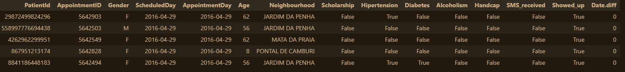
Loading in the Data (1/3)
Kaggle Link
100k + medical appointments in various neighborhoods in Brazil
Notice anything wrong?

Slide 3
Loading in the Data (2/3)
Kaggle Link
100k + medical appointments in various neighborhoods in Brazil
Notice anything wrong?

Slide 4
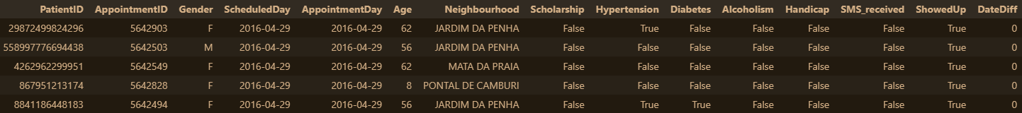
Loading in the Data (3/3)
Kaggle Link
100k + medical appointments in various neighborhoods in Brazil
Notice anything wrong?

Slide 5
Data Characteristics and Project Goal
Goal: Predicting ‘ShowedUp’ – Whether or not a patient will show up to their appointment.
Classification Problem
15 Features

Slide 6
Notable Features
PatientID Repeated patients
Scholarship Whether or not the patient is on Brazil’s social welfare program “Bolsa Família”
SMS_received whether 1 or more text messages were sent to the patient
Notes:
Note: The scholarship program has strict conditions such as requiring to be vaccinated and children attending school, so it’s not strictly that the patient is of low-income. Bolsa Família - Wikipedia

Slide 7
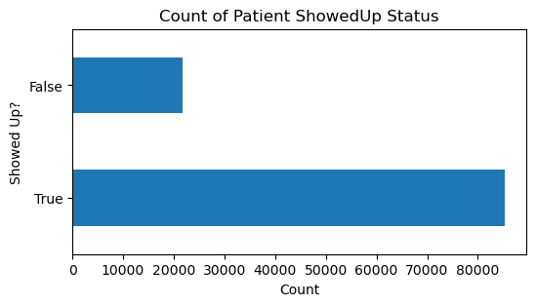
EDA (1/3) – ShowedUp
Visualizing our target variable
It’s wildly imbalanced!

Slide 8
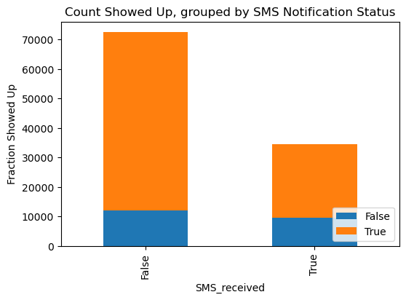
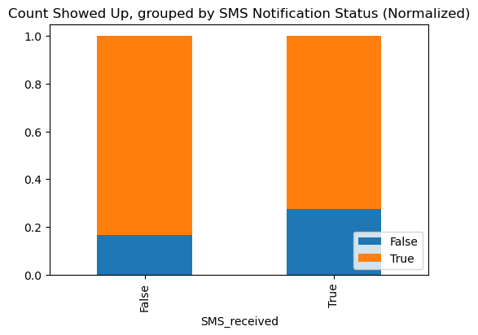
EDA (2/3) (wip)
SMS_received is unbalanced
Normalized shows a marginal improvement
Notes:
SMS_received is unbalanced – why aren’t most people being sent sms text messages to remind them of their appointment?

Slide 9
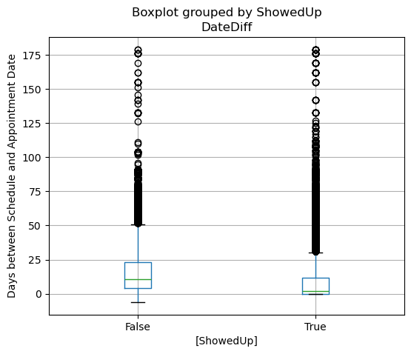
EDA (3/3) – Target Variable
People who show up tend to schedule their appointments closer to the day of
Negative date diff?
Large outlier count

Slide 10

Splitting Data
Given:
Target variable is unbalanced
Data is not iid
Therefore:
Stratify
Group!
Notes:
StratifiedGroupKFold

Slide 11

StratifiedGroupKFold
Stratify ‘ShowedUp’
Group by PatientID
Splitting
Trainval and test (n_splits = 5)
Train and validation (n_splits = 4)
Notes:
Stratify so that we can keep the same proportion of classes on each fold
splits i.e. 100
n splits = 5 --> trainval 4, test 1 --> 80, 20
n splits = 4 --> train 3, val 1 --> 60, 20

Slide 12
Preprocessing
Gender
ScheduledDay and AppointmentDay
Neighbourhood
DateDiff

Slide 13
Gender → Converting to Binary
‘M’ → 1
‘F' → 0

Slide 14

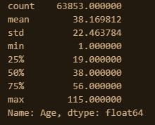
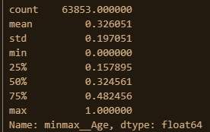
Age → Normalization

Slide 15
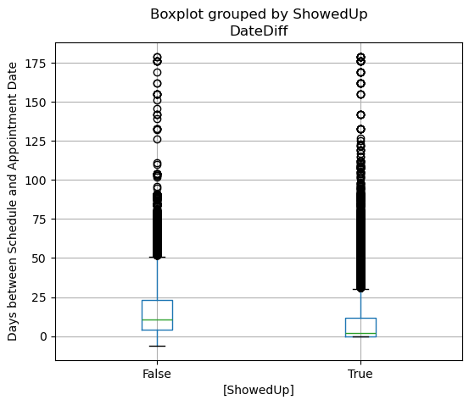
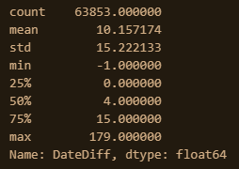
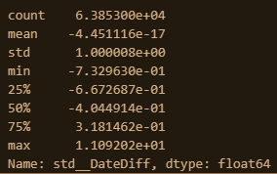
DateDiff → Standardization

Slide 16
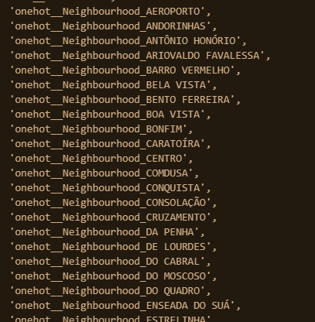
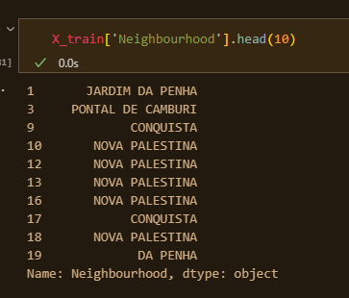
Neighbourhood → One-Hot Encoding
80 new features

Slide 17
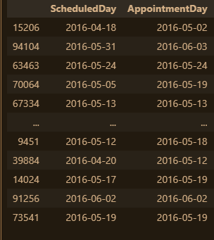
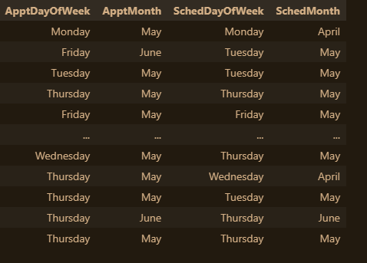
ScheduledDay & AppointmentDay → One-Hot Encoding(1/2)
Feature Engineer _DayOfWeek and _Month columns
Notes:
Thoughts: Given that we have several repeated patients in our dataset, it would stand to reason that the feature values for each of their appointments are identical other than in ScheduledDay, AppointmentDay, and DateDiff. Therefore, feature engineering based on these columns could further differentiate the date?

Slide 18
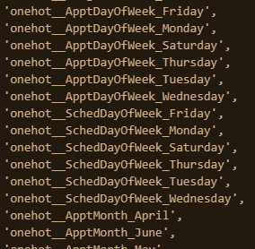
ScheduledDay & AppointmentDay → One-Hot Encoding (2/2)
…and then one-hot encoded using those new columns
~23 new features

Slide 19
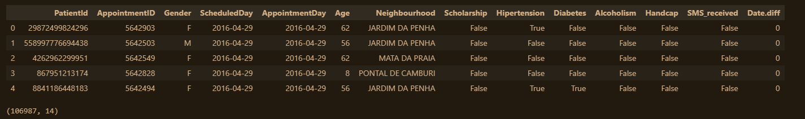
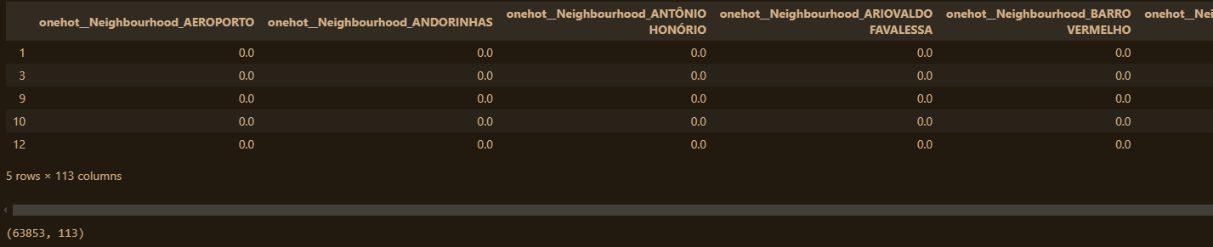
Preprocessing: Before and After

